Slide 1
Desire for Asian Goods
Notebook Entry #1

Slide 2
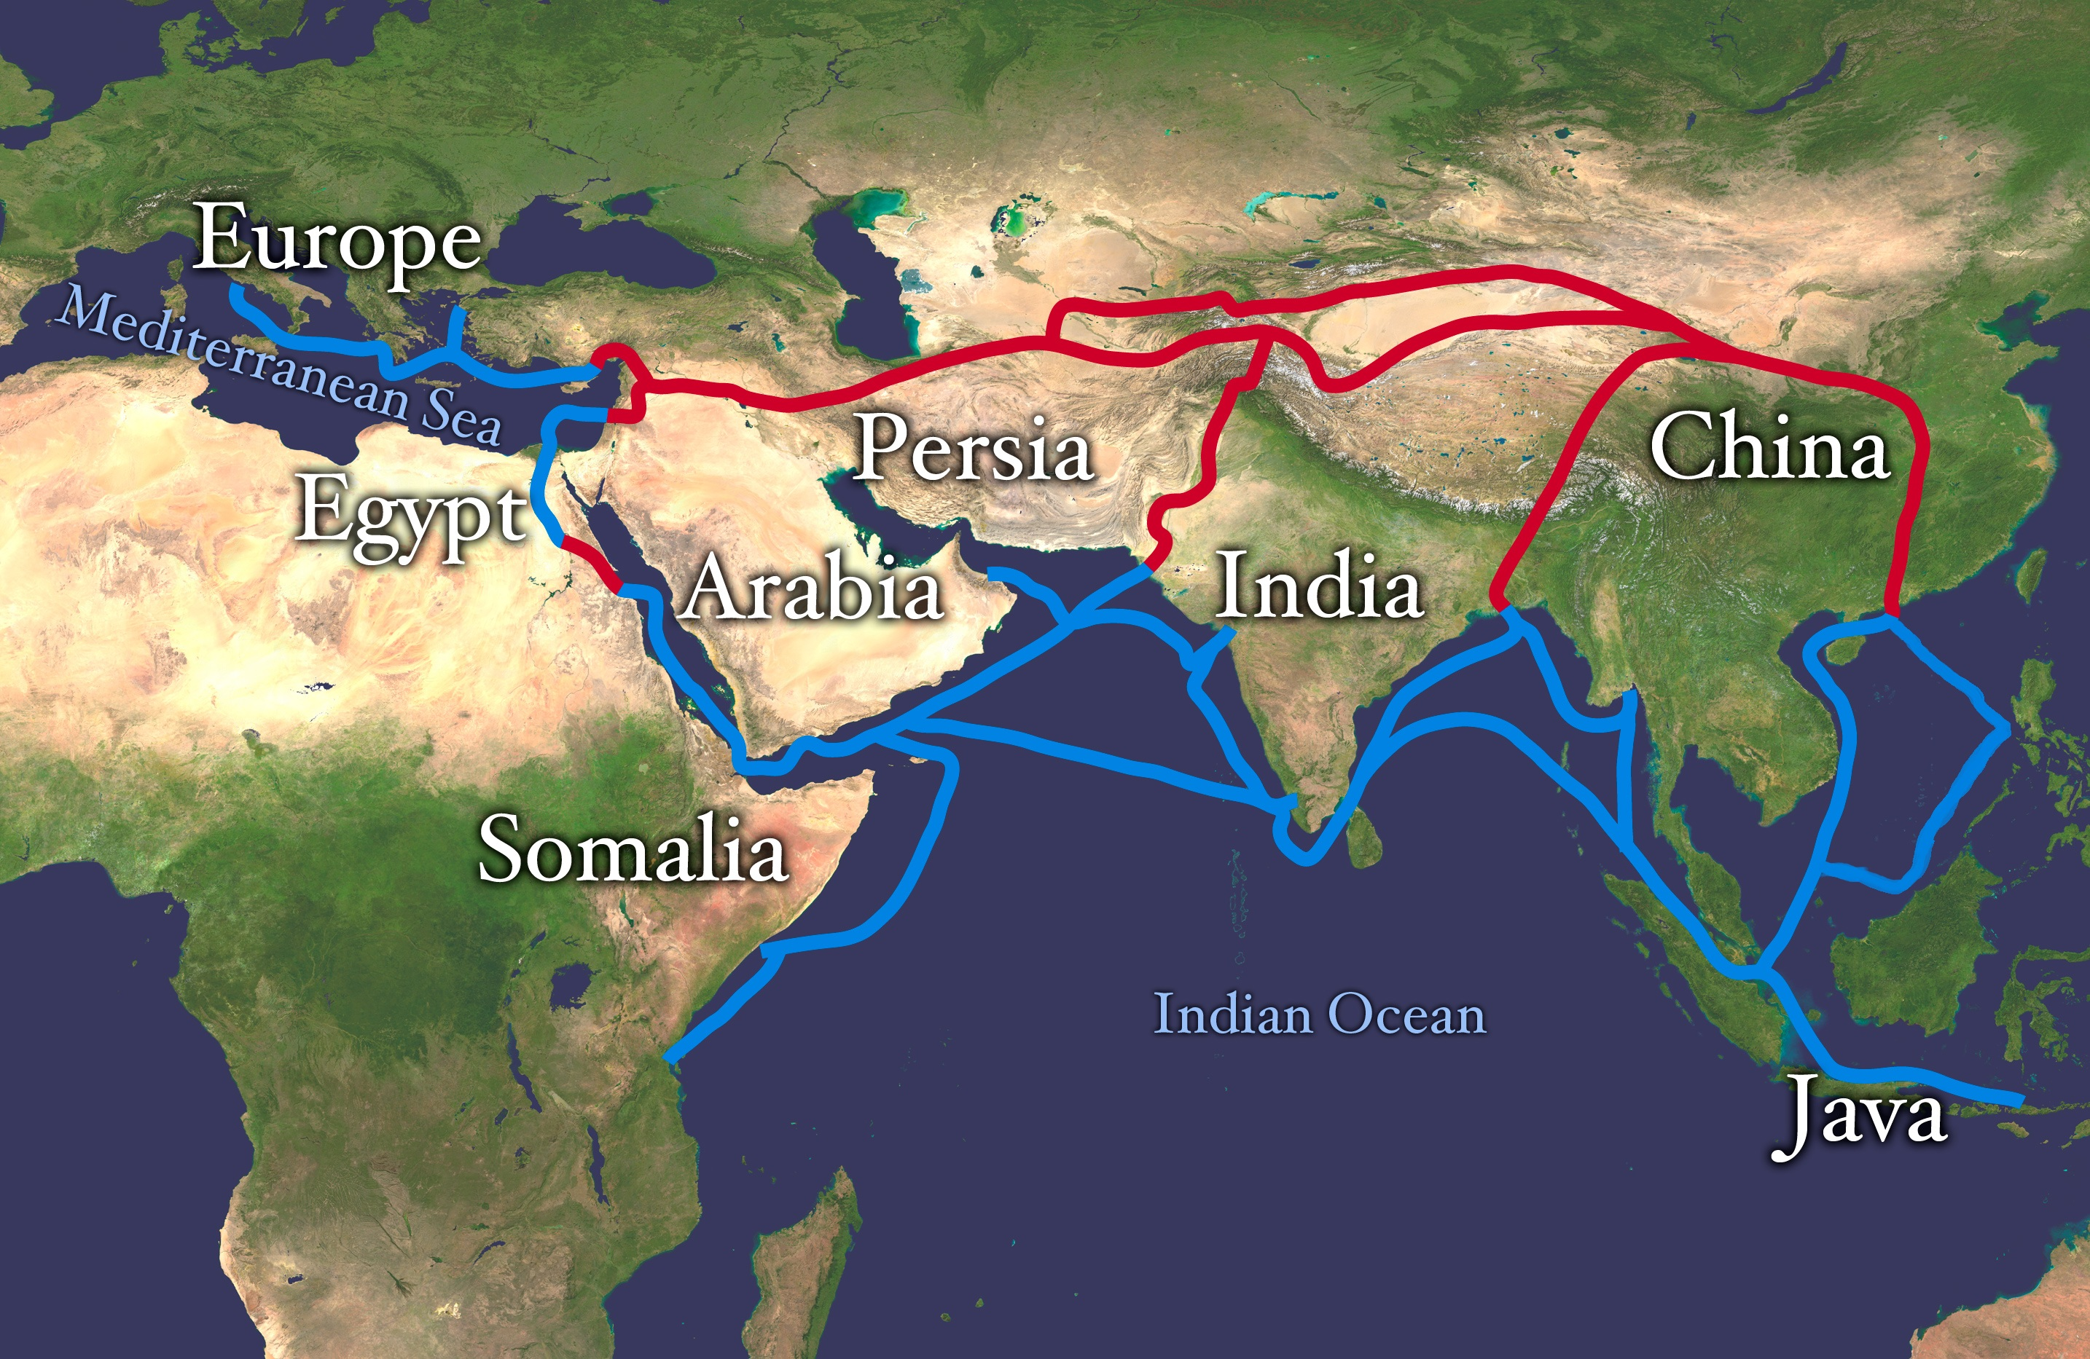
Europeans “Discover” Asian Commodities
European Crusaders to the Middle East brought back to Europe, Asian goods, particularly spices.
The demand for these goods increased.
Silk Road, path from the Mediterranean to Asia, facilitated Europe’s trade with Asia, particularly China.
Cost effective thanks to the infrastructure of the Mongol Empire.

Slide 3
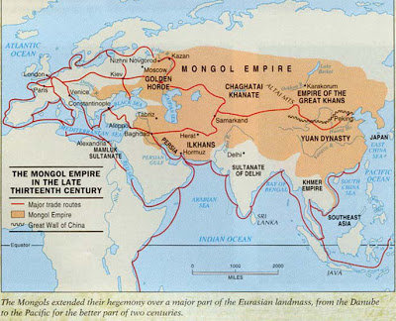
Europeans have difficulty obtaining Asian Goods
Collapse of Mongol Empire means that trading, along a land route, with Asian merchants becomes too expensive.
Middlemen along the route raise prices to make a profit.
Land route becomes less profitable so Europeans start looking for new routes.

Slide 4
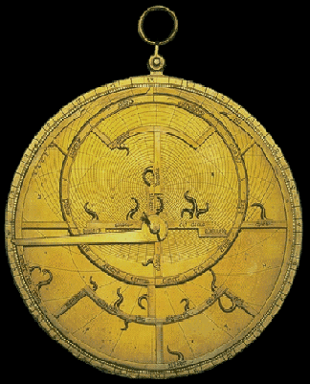
Europeans Overcome Difficulty in Obtaining Asian Goods
New technologies allow Europeans to traverse (travel) by ship to India and China.
  Astrolabe – Using position of stars as a way to measure ship’s location.
  Caravel – New ship design allowing people to sail into the wind.
Henry the Navigator founds school to share these advances in Portugal.

